Slide 1
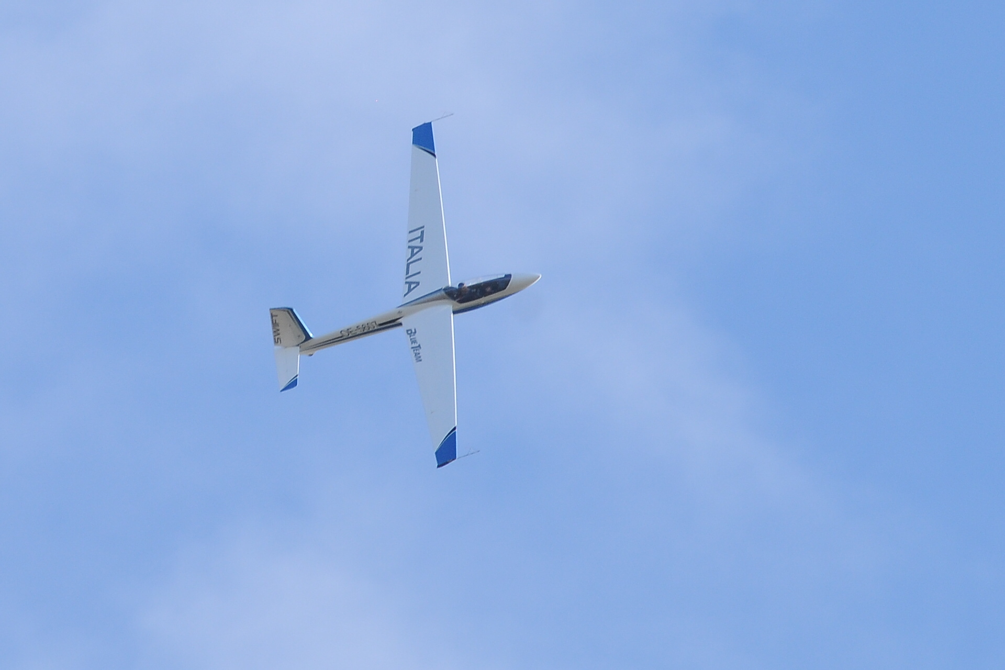




World aerobatic glider championship 2020
TERNI – ITALY
CATEGORY : ADVANCED - UNLIMITED

Slide 2
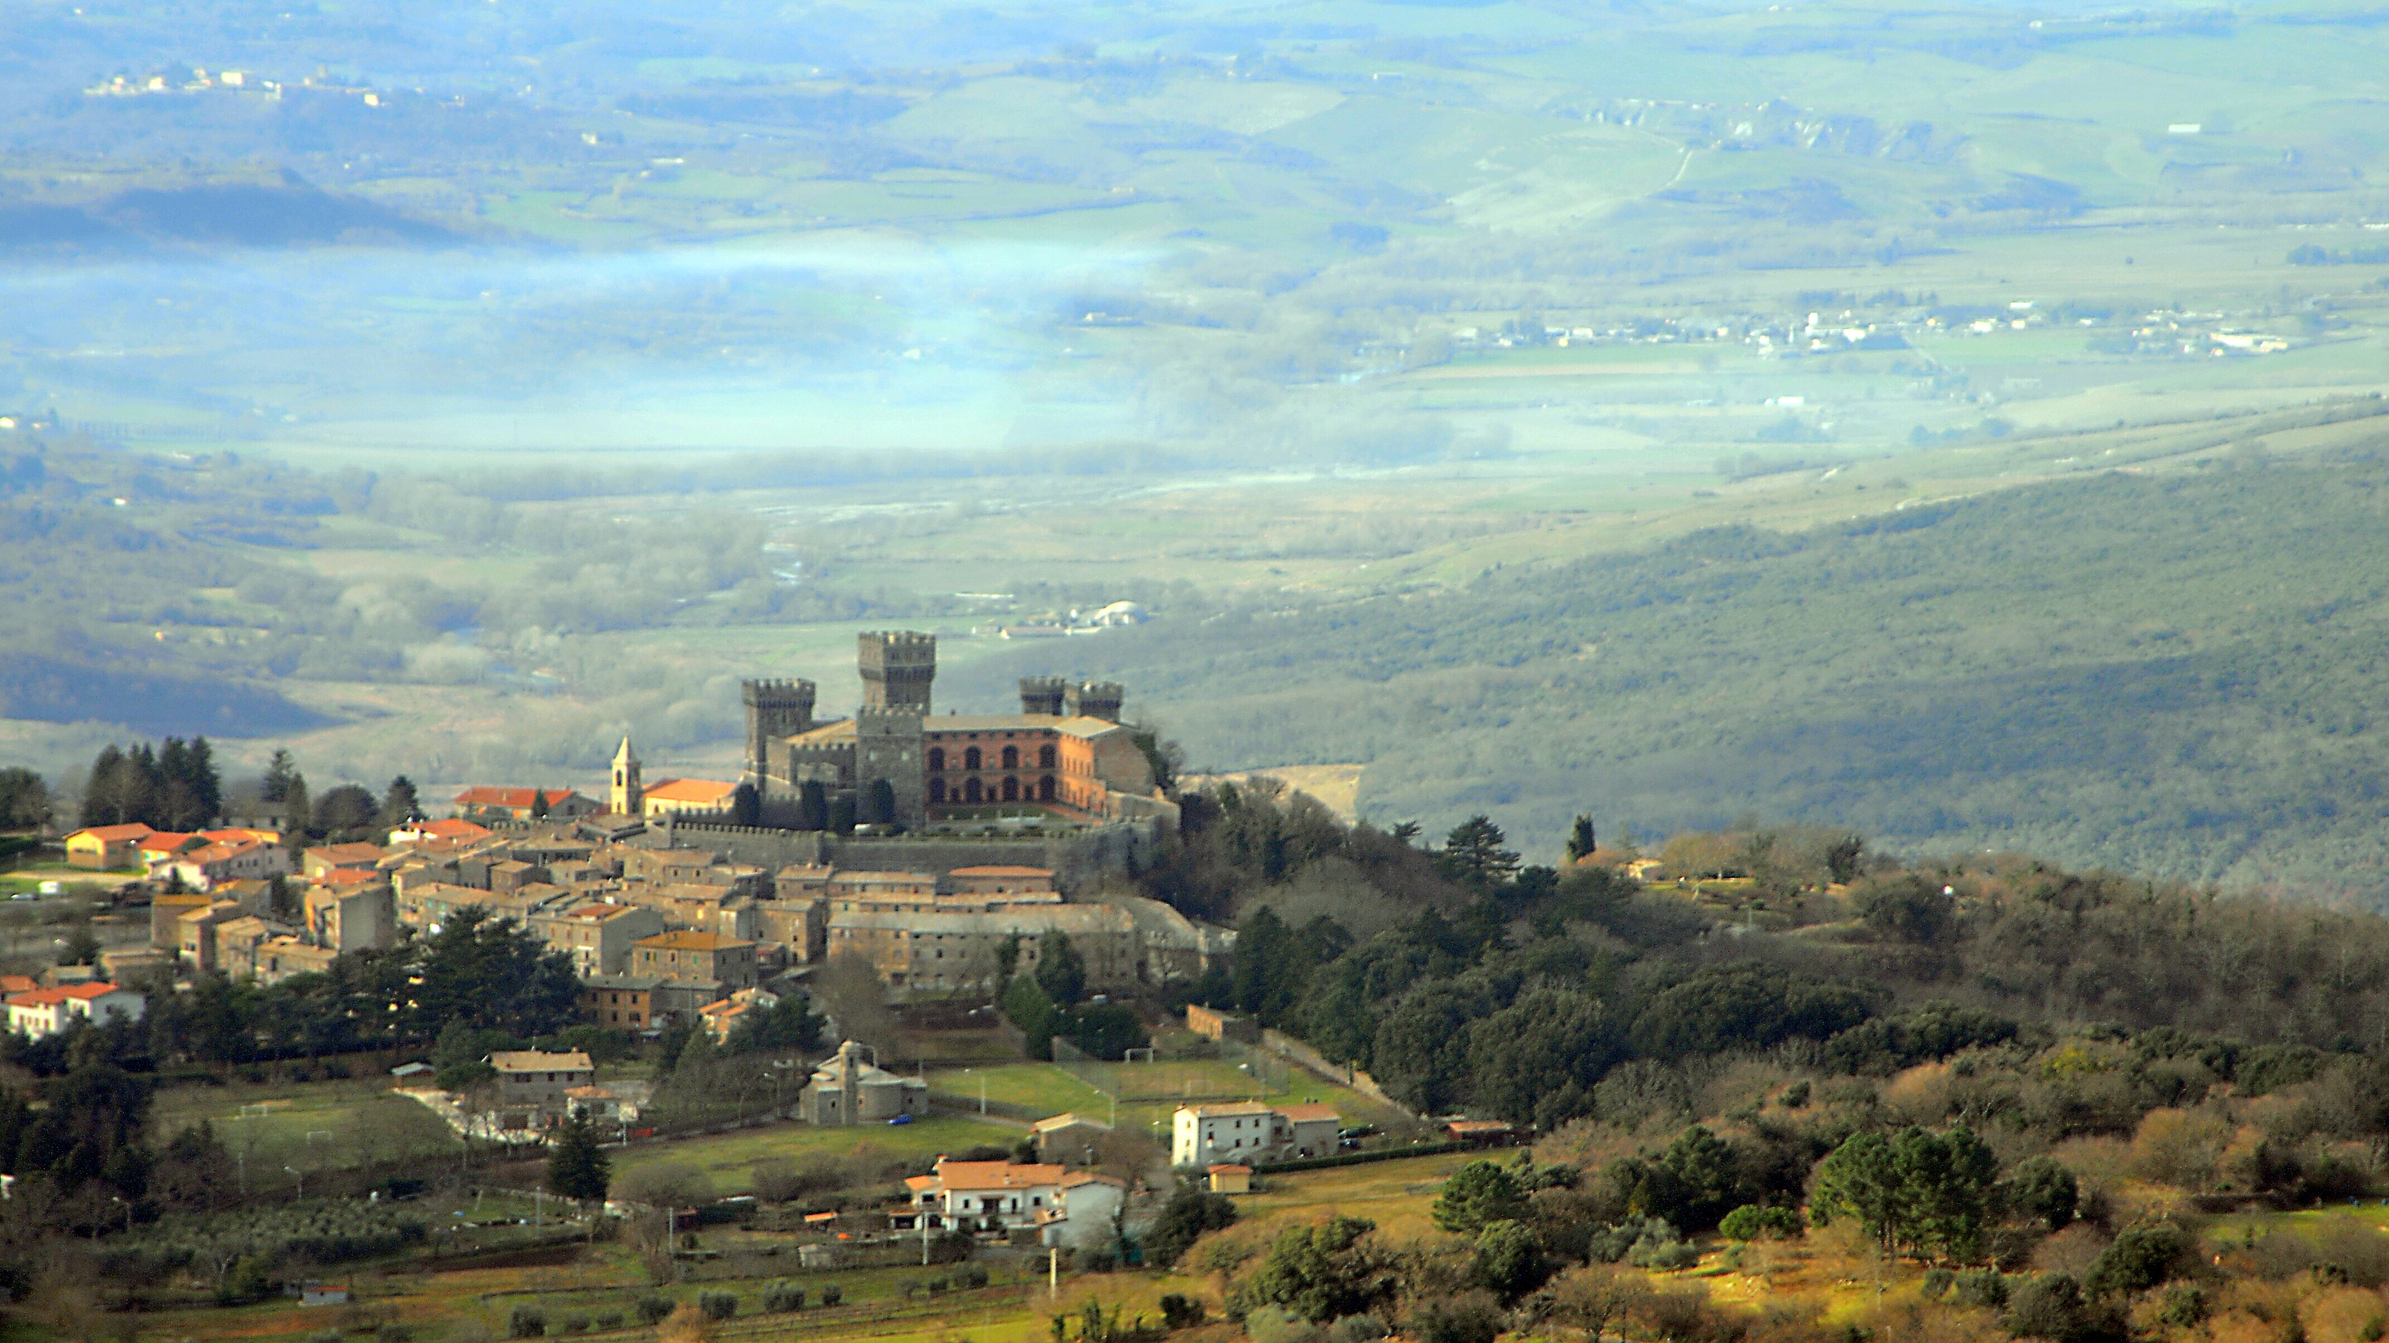
Resume of the Presentation
Postcard from TERNI;
Description of the area;
Why?
How to get Terni;
Location for fly acro-Technical overview;
Logistic Support on the airfield;
Test events - Alfina Base, availability ;
Date and Plan

Slide 3
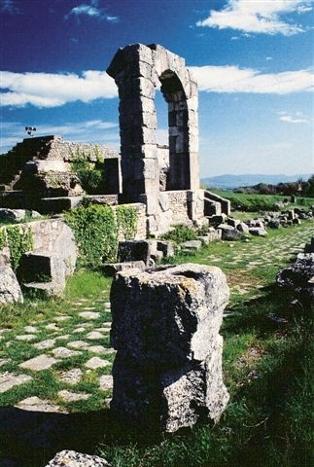
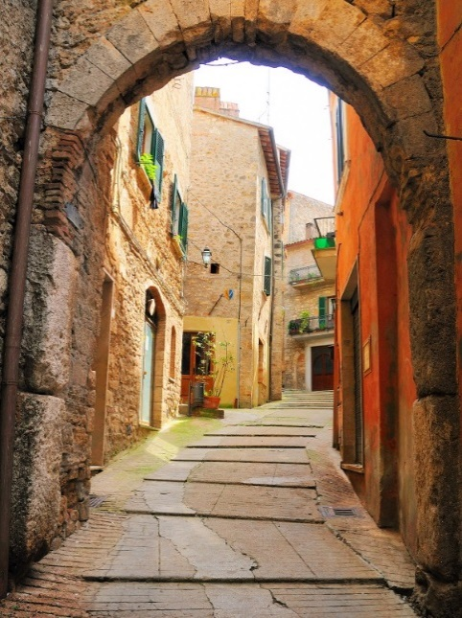

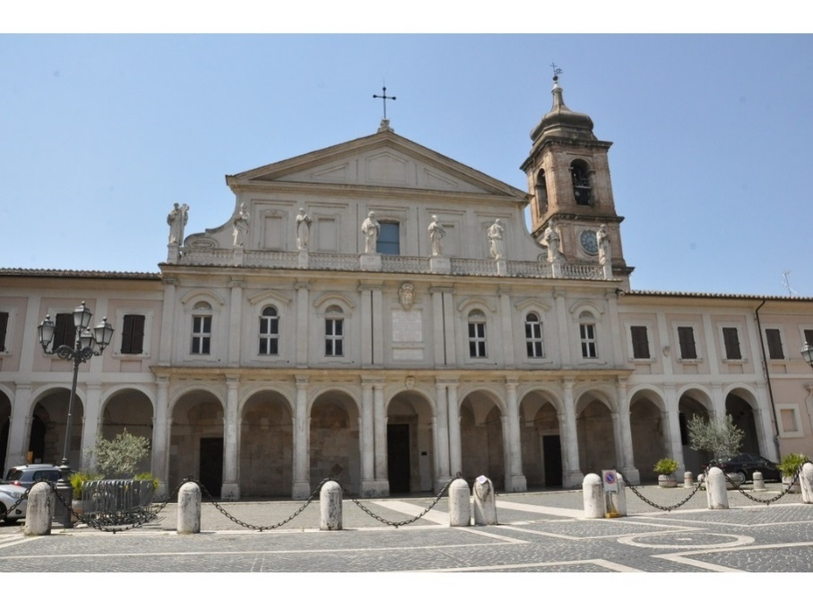
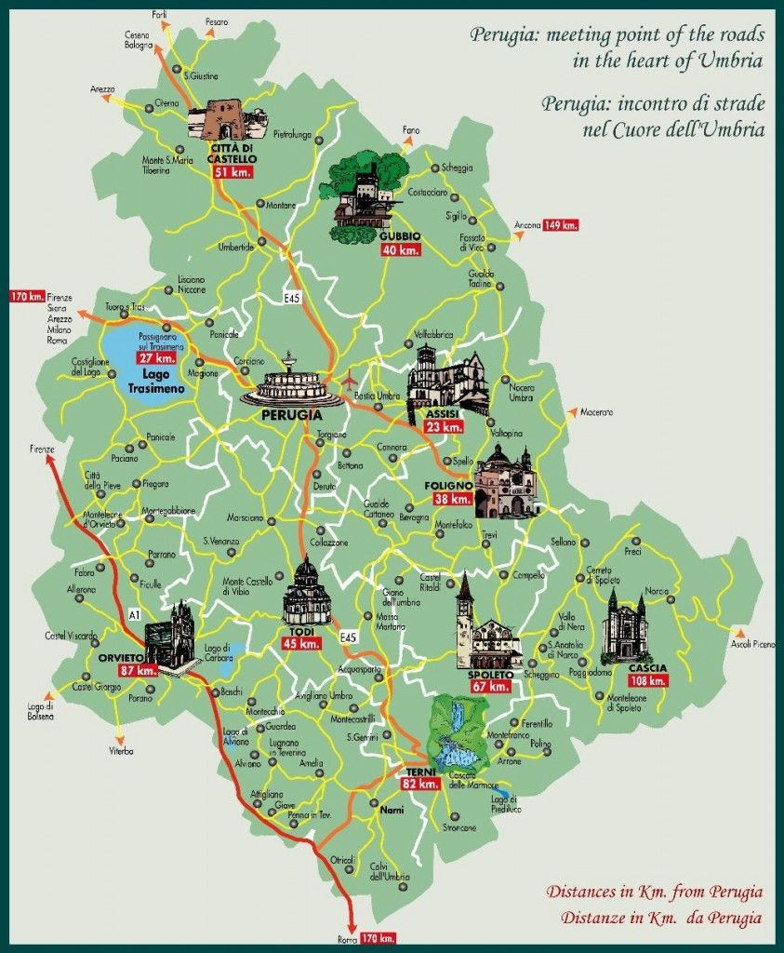
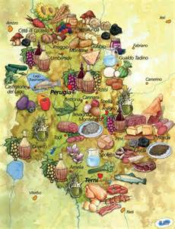


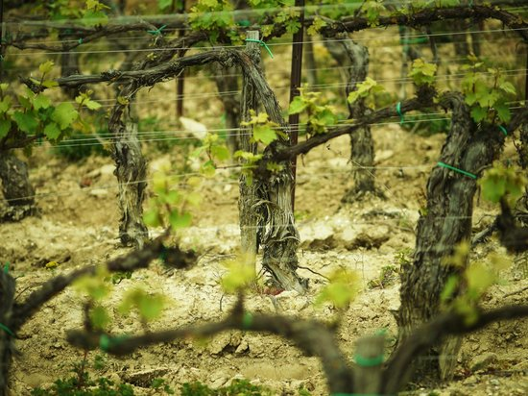
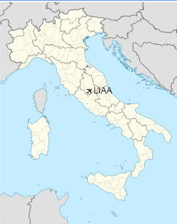
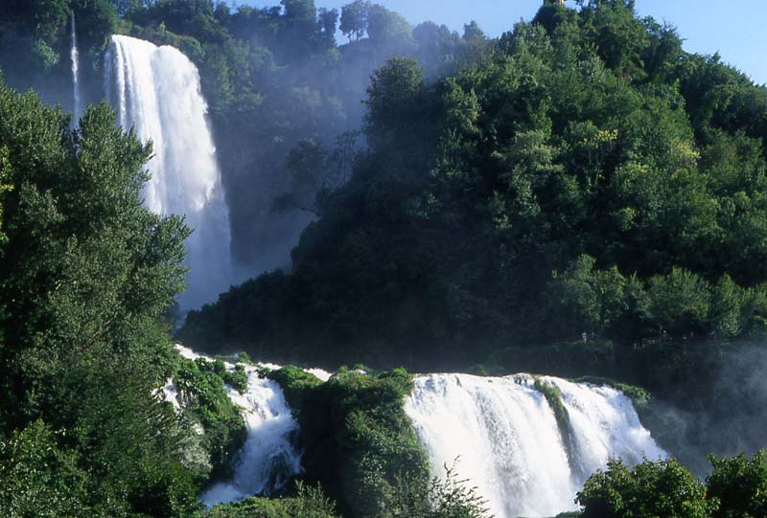




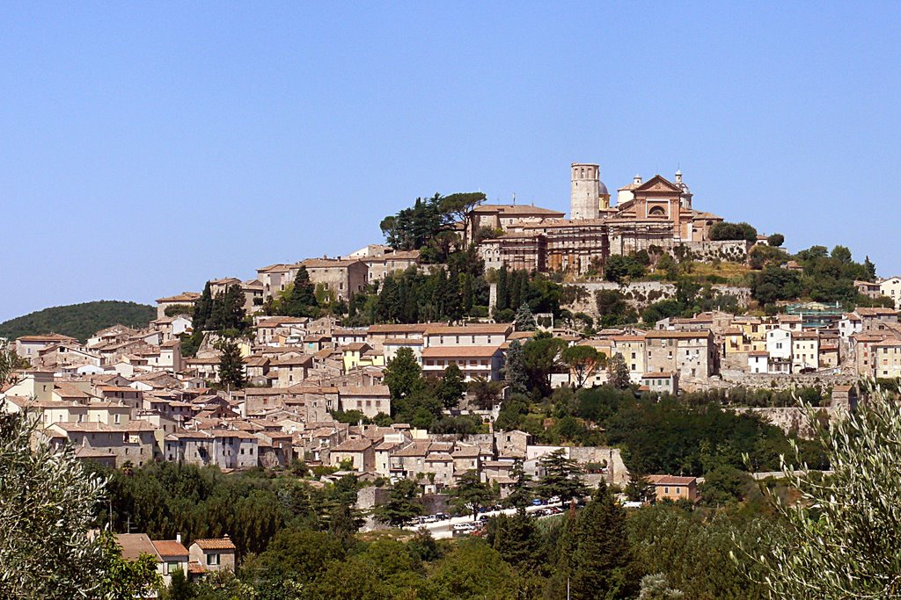
Postcard from Terni, in center of Italy

Slide 4
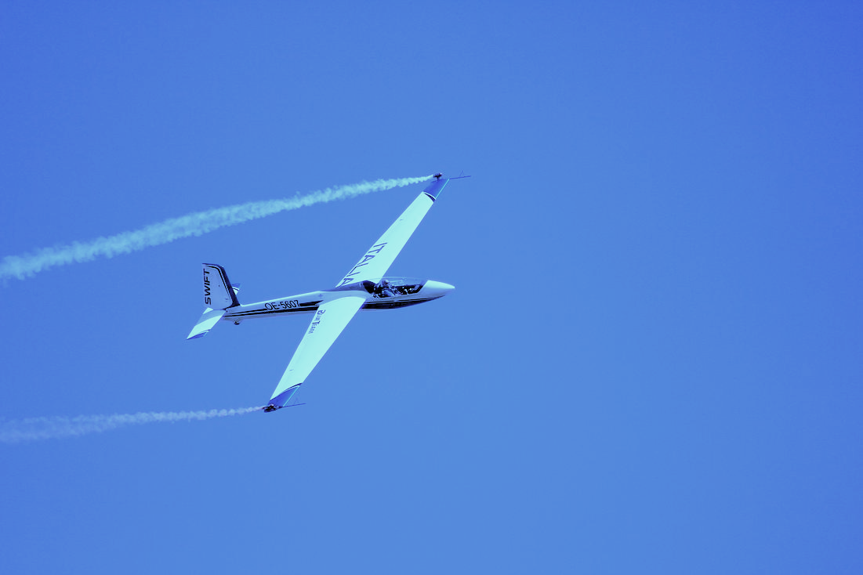




TERNI the CITY along
the story- The past
Terni is a city in the southern portion of the Region of Umbria in central Italy. The city is the
capital of the province of Terni, located in the plain of the Nera river. It is 104 kilometres (65
miles) northeast of Rome. It was founded as an Ancient Roman town.
During the 19th century, steel mills were introduced and led the city to have a role in the
second industrial revolution in Italy. Because of its industrial importance, the city was heavily
bombed during World War II by the Allies. It still remains an industrial hub, and has been
nicknamed "The Steel City" and the "Italian Manchester".
Terni also advertises itself as a "City of Lovers", as its patron saint, Saint Valentine, was born
and became a bishop here and the remains are preserved in the basilica-sanctuary in his
honor.Actual population is 111.455, on 211 km² - 530/km² is the density.
The actual capability of the city in terms of tourism flow is a primary characteristic of the
Area.

Slide 5
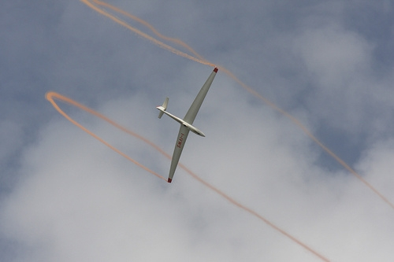

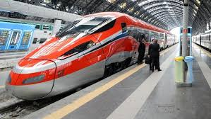
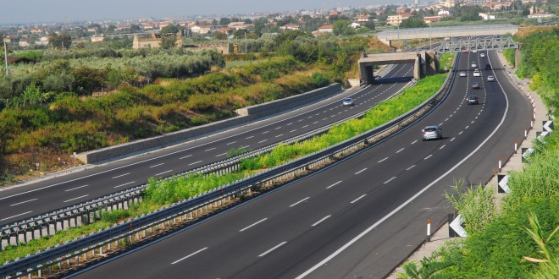
How to get the Airfield Alvaro Leonardi
By Plane:
Low cost flights from main European cities are available to Perugia,
Rome, Ancona, Florence, Pisa. When specify requested is possible to organize transfers by plane for minimum 4 people. The same transfer by small dedicated bus is a good method to get the airport headquarter of the event.
By Train:
From Rome Termini Station (main Rome station): a train every hour will take you to get the city in 60 minutes. From Terni station, a shuttle bus will take to the Airfield.
From Milan, Florence, Venice there are fast trains till Orte station where you can find connection to Terni.
By Car : From Rome, Milan, Turin, Florence, Naples : take motorway A1 till gate Orte. Take the road junction Orte -Terni to Terni direction. Follow direction Terni gate, road junction Perugia-Cesena- Flaminia industrial Zone; immediate right direction to Flaminia Industrial Zone. As soon as out take the road indicating the Center of Terni. Going ahead for 1500mt till the left sign indicating the airfield. Follow the Airfield sign to the Airport.

Slide 6
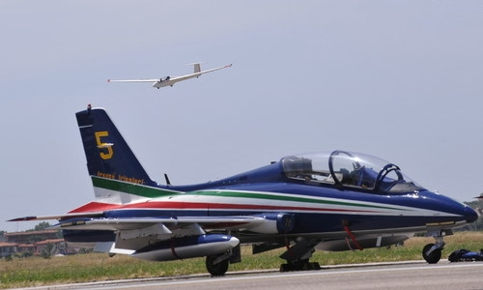
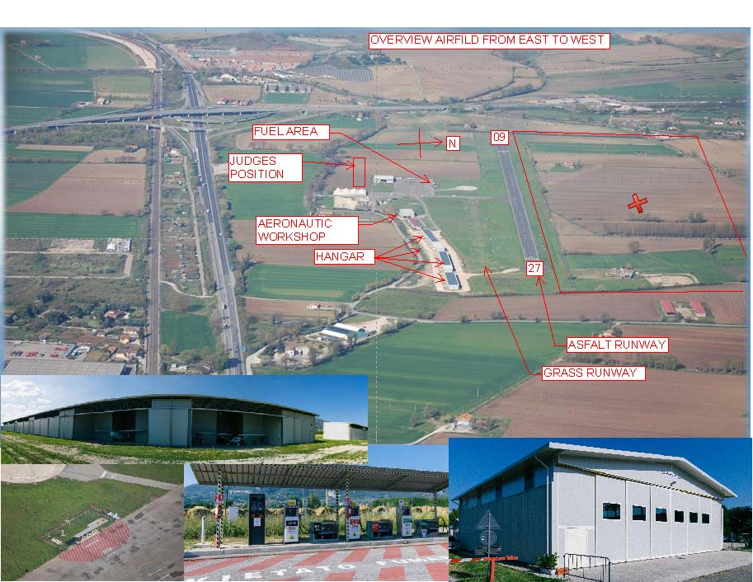
AIRFIELD ALVARO LEONARDI – TERNI

Slide 7
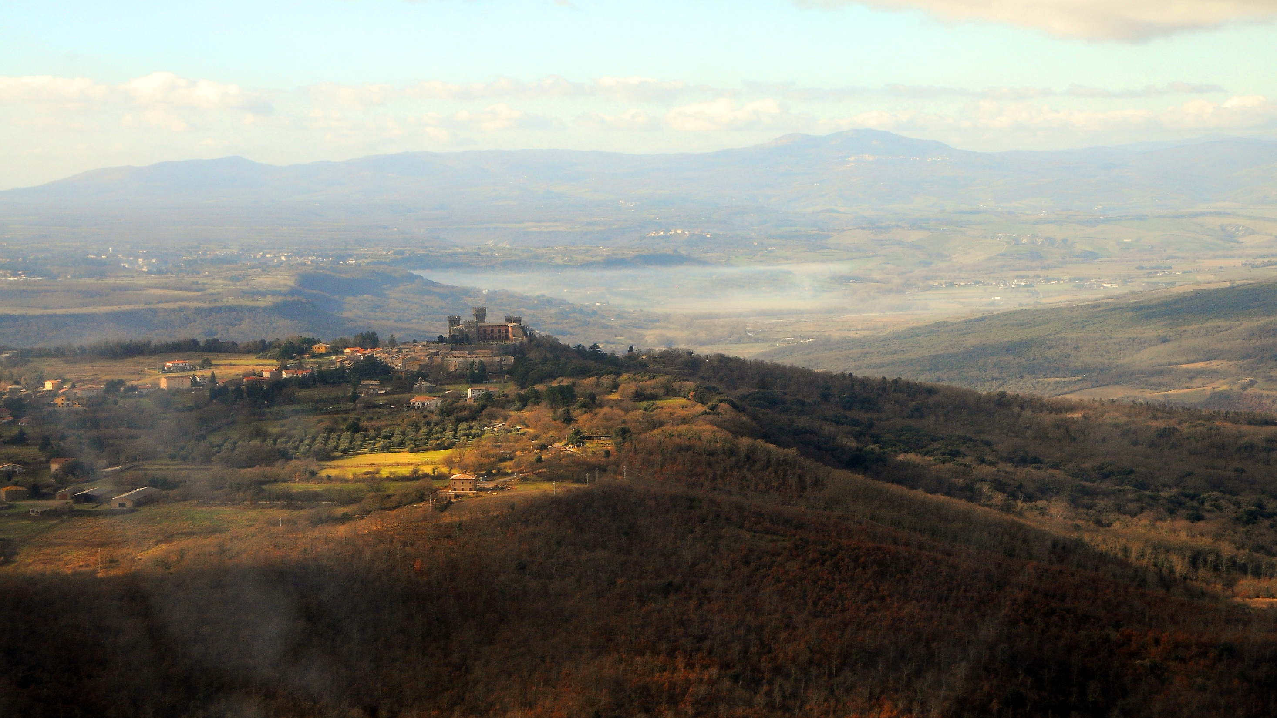
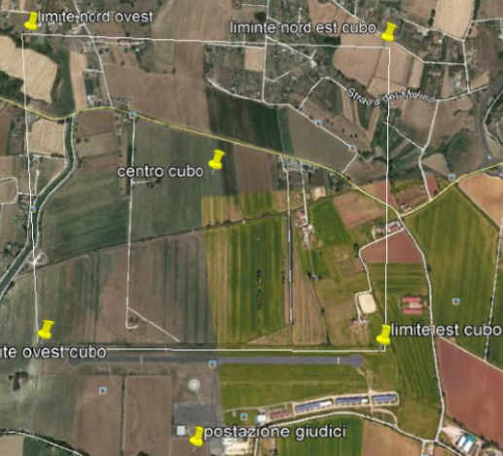
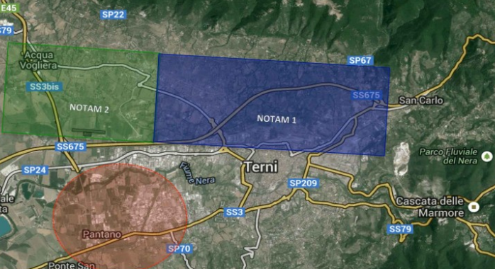
ICAO CODE: LIAA
Coordinate: lat 42° 34’ 24’’ N – long 12° 35’ 04’’ E (42°34, 390’ N 012° 35, 06’ E)
MAIN RUNWAY CONCRETE LENGTH 900 X 18 WIDE mt – TAKE OFF PREVALENT DIRECTION 27 – LANDING PREV DIR 09 – AVALABLE FOR MTOW 5.700 Kg
Secondary grass runway 500 mt x 20 mt
Hangar for gliders capabilities
THIS AIRFIELD CAN ACCEPT THIS TUPE OF TRAFFIC: General Aviation, Air taxis, Assistance (Red Cross, Civil Protection, Police), Flying school, Gliding, Ultra-light, Parachuting, Hot-Air Balloons.
AIRFIELD
LIAA
N
Airfield has two landing RUNWAY
TWO PERMANENT NOTAM ACTIVE

Slide 8
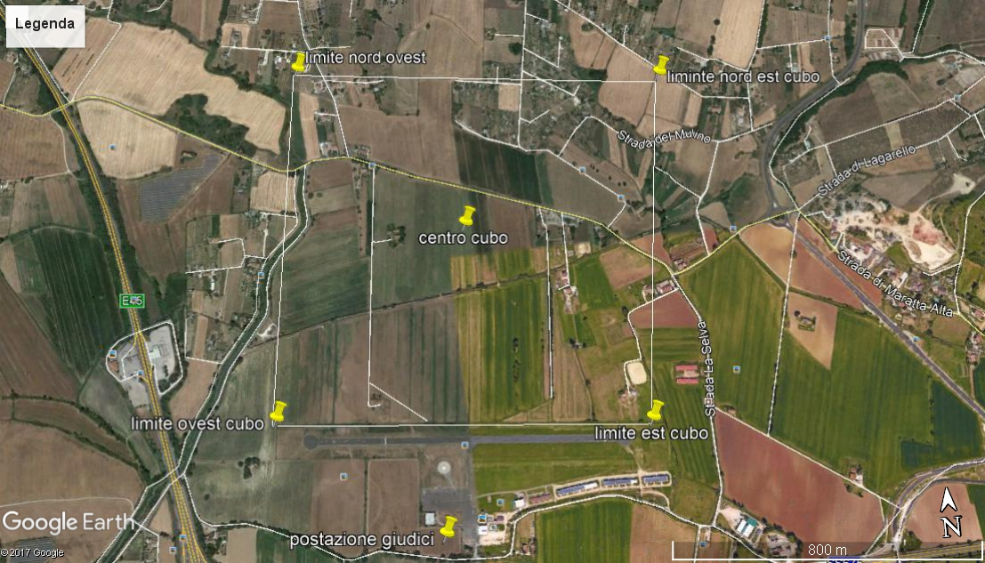
N

Slide 9
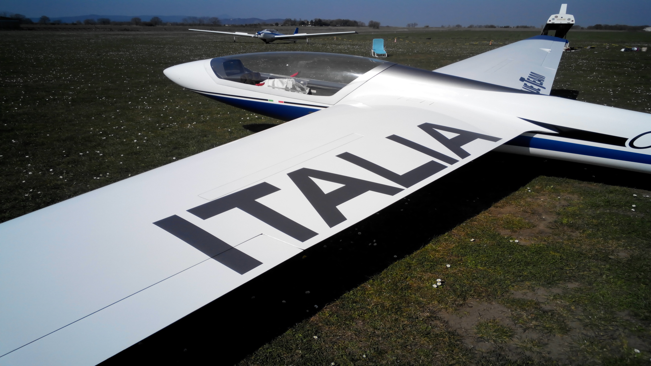
PLAN & EVENTS
INTERNATIONAL TEST ON THE AIRFIELD CAN BE DONE DURING 2019;
TRAINING BASED ON TERNI AIRFIELD AND/OR ALTERNATIVE AIRPORT “ALFINA – CASTEL VISCARDO WILL BE POSSIBLE FROM 1st of JULY 2020;
ALFINA AIRFIELD – BASE OF THE ITALIAN AEROBATIC TEAM IS ALWAYS AVAIALBLE FOR TRAINING PROPERLY PLANNED;
CHAMPIONSHIP PROPOSAL DATE – FROM 27th of JULY to 9TH of AUGUST 2020.

Slide 10
FEES
Registration competitors : € 750,00;( the entry fees doesn’t include the expensives of accomodation, meals or towing services)
Team Members : € 300,00;
Family Members : free;
Competition towing fee to 1250 mt : € 65,00
Registrations and towing costs may be lower in function of sponsor availability
Meteo forecast will be offered by Aeronautica Militare Italiana ( Italian Air Force)

Slide 11
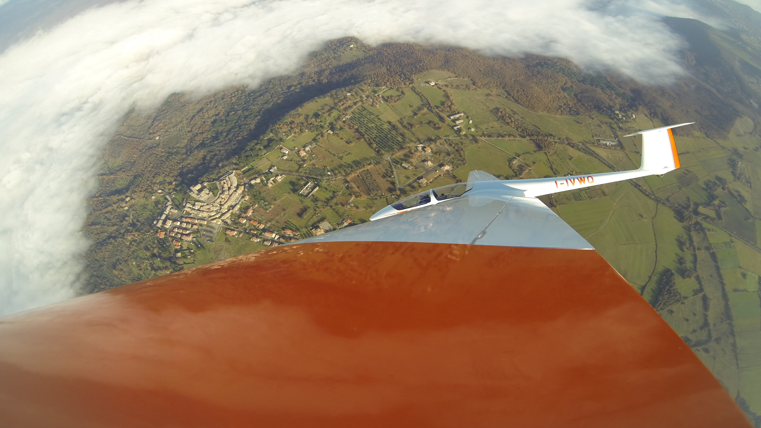
Thanks for the attention, from Italian Aerobatic Team !

